Slide 1
Chapter 1: The nature of real estate (RE) and RE markets
Real Estate Principles: A Value Approach
Ling and Archer

Slide 2
Outline
The nature of real estate (RE)
RE and the economy
RE markets and participants
Characteristics of RE markets
Professional career

Slide 3
Real estate
RE is property.
Property refers to anything that can be owned or possessed.
Property can be (1) a tangible asset, e.g., a building, or (2) an intangible asset, e.g., a lease agreement.

Slide 4
RE
We use the term “real estate” in 2 ways: (1) we use it to refer to tangible assets, e.g., lands and buildings, and (2) we use it to denote the bundle of rights that give the owner of the rights to use tangible assets.

Slide 5
RE as tangible assets
RE can be defined as the land and its permanent improvements.
Land may include (a) the surface of the earth, (b) rights to air space above the land up to a certain height, (c) rights to the subsurface down to the center of the earth and to the minerals contained therein, and (d) the improvements to the land, e.g., walkways and water drainage systems.
The improvements on the land, e.g., buildings, fences, and decks, are also parts of real estate.

Slide 6
RE as a bundle of rights
The bundle of rights is the services (benefits) that RE provides its users. For example, RE provides owners with the rights to shelter, security, privacy, doing business, etc.

Slide 7
RE as an industry: career
The industry has a variety of professions: (1) brokerage, (2) leasing and property management, (3) appraisal, (4) consulting and advising, (5) property development, (6) construction, (7) financing, mortgage, and securitization, (8) investment, and (9) governmental planning, taxation, and regulation.

Slide 8
Some definitions
Raw land: land that does not include any improvements, i.e., no streets or other infrastructure.
Real property: often interchangeable with the term “real estate.”
Personal property: things that are movable and not permanently affixed to the land, e.g., refrigerator.

Slide 9
RE and the economy
Half of the world’s wealth.
Generates 28% of U.S. GDP. Housing alone accounts for almost 20%.
Generates 70% of local government revenue (property tax).
Creates jobs for nearly 9 million Americans.

Slide 10
Xi Jinping Doesn’t Know What to Do After Popping a Real-Estate Bubble
China’s economy has reached a perilous phase. Data for November, released this week, show investment and consumption slowing. New home prices are gliding downward, and property investment is letting up.
The economy is feeling the aftershocks of Mr. Xi’s biggest economic project of the past year, a controlled implosion of China’s outsize property market. The loudest kaboom has come from Evergrande Group, a property developer indebted to the tune of around $300 billion that finally defaulted on a bond payment earlier this month.
Source: WSJ, 11/2021.

Slide 11
Land use
Developed land consists of residential, industrial, commercial, and institutional land uses (e.g., sanitary landfills).
Developed land represents about 6% (this share is growing over time) of the land in the U.S.
A typical single-family residential lot is about 0.2-0.8 acre.

Slide 12
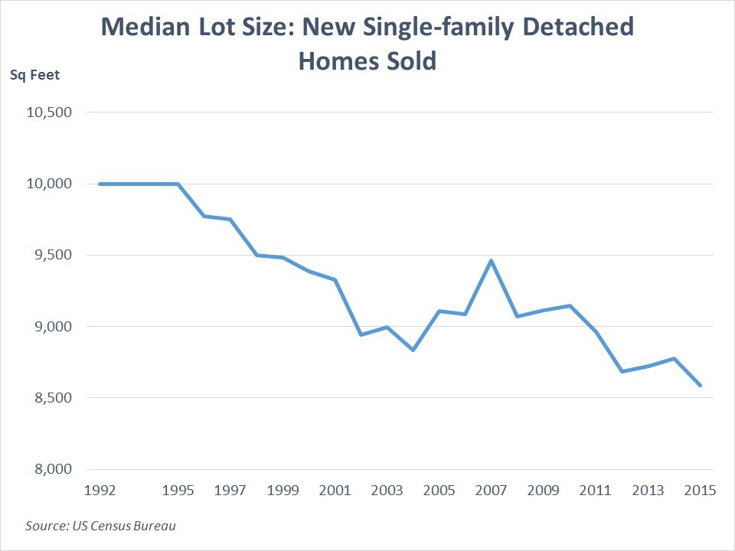
Narrow lot: < 0.2 acre now

Slide 13
RE’s impacts on economy and society
“Nearly 40 percent of (Japanese) singles in their 20s and 30s do not want a romantic partner, with many calling relationships “bothersome,” according to a government survey released (in 2015).”
“They simply can't afford it. Wages have stagnated since the 1990s, while housing prices have shot up. A young Japanese man has good reason to believe that his standard of living would drop immensely if he had to house and support a wife and children.”
Fertility rate in Japan: 1.3 births per woman.
Source: The Week, The Japan Times

Slide 14
Also in the U.S.
A recent decline in fertility was sharpest in (U.S.) counties where home values rose the most.
An extra 10 percentage-point rise in home values was associated with an extra 1.5 percentage-point drop in birth rates for 25- to 29-year-old women.
Source: Zillow Research

Slide 15
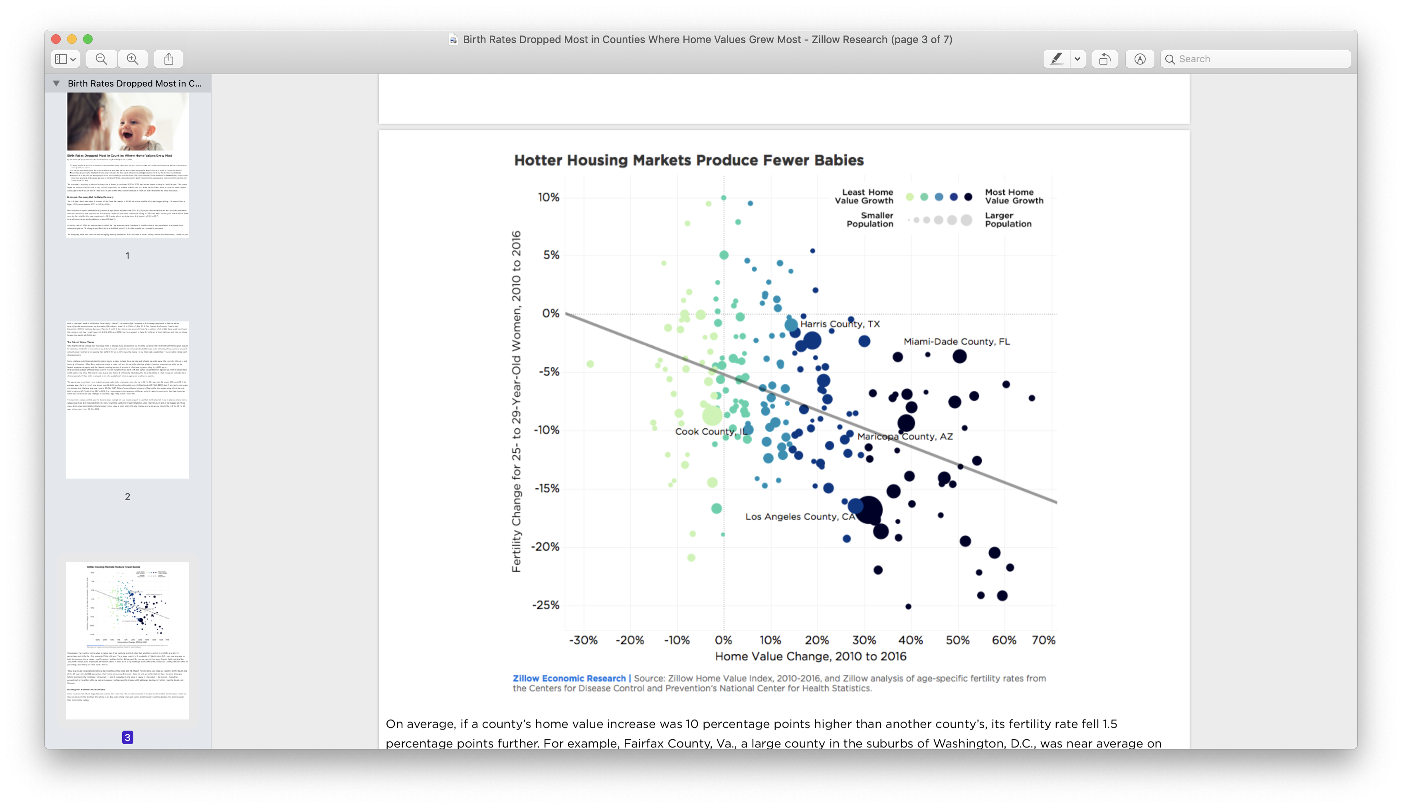

Slide 16
China's Birth Rate Plunges As The Housing Bubble Shatters The Dreams Of Young People
China's birth rate is plunging, as soaring home prices shatter the dreams of young people of buying a home and raising a family.
China has a severe birth rate problem. In 2020, the country's rate stood at 8.52 per 1,000 people, down from 10.41 in 2019
The continuing drop in China's birth rate may be a big surprise to China observers, as it comes five years after its leadership relaxed the old one-child policy, allowing families to have more children.
Apparently, the policy isn't working, and there's a good reason for it: The property bubble.
Source: IBT, 11/2021

Slide 17
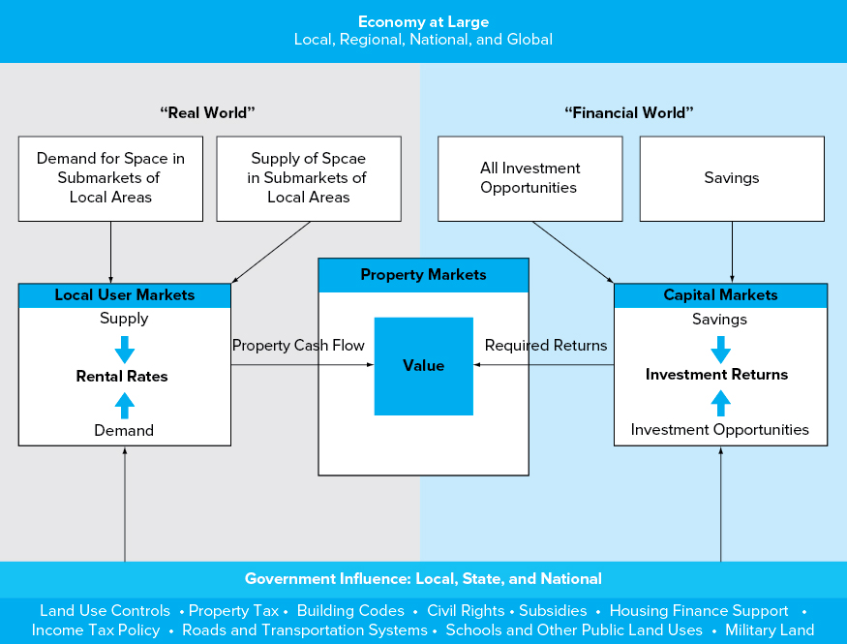
Interactions in RE markets

Slide 18
User (space) markets
Markets for the physical RE.
“Buyers” receive right to use space.
Sometimes called “space” market or “rental” market.
Where rental rates are determined.

Slide 19
Segmentation, I
User (space) market are segmented.
Rental prices for physically similar space can vary widely (1) across locations, and (2) across property types.
Both demand and supply side of user markets are very specific to location and building type.

Slide 20
Segmentation, II
In contrast, integrated markets (e.g., gasoline, steel, financial capital) are characterized by homogeneous commodities that can be moved from place to place.

Slide 21
Capital markets
RE competes for funds in capital market with other asset classes, such as stocks and bonds.
Investors select a mix of investments based on expected returns and risk.
Bidding by investors determines required risk premiums for RE investments.
Capital markets are largely integrated.

Slide 22
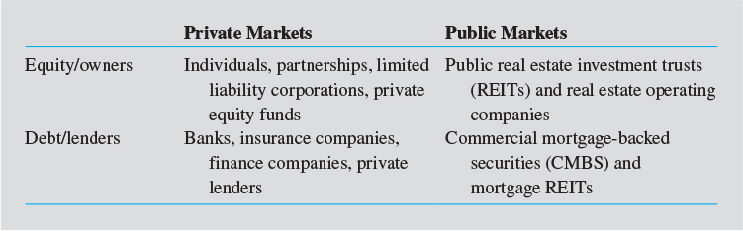
4 quadrants of RE capital markets

Slide 23
Local governments
Zoning codes and other land use regulations.
Fees on new land development.
Building codes.
Property taxes.
Infrastructure.
Local governments usually have the largest influence on RE.
Local developers specialize in collecting information about local market demands and regulations.

Slide 24
Transaction/sales tax
“Foreigners looking to purchase a home in Vancouver now face an additional tax of 15%, as Canadian authorities seek to temper a heated housing market that ranks as one of the world’s least affordable.”
“Announcing the measure, the provincial government of British Columbia said the tax was intended to help cool the city’s red-hot property market, where demand from foreign investors – many of them from China – has helped push the cost of a detached home to C$1.56m ($1.2m) in June, a 39% jump from a year earlier.”
The Guardian, 08/02/2016

Slide 25
State government
Licensing of RE professionals and agents.
Statewide building codes.
Fair housing laws.
Basic framework for land use controls.

Slide 26
State licensing
The Vermont Real Estate Commission administers all aspects of the real estate law within the state of Vermont.
The requirements for a real estate salesperson license in VT include (1) being at least 18 years old, (2) passing the real estate examinations after completing the prelicensure requirements of 40 hours of real estate education from an approved real estate school, (3) the salesperson applicant needs to be sponsored by a licensed Vermont broker and be associated with that broker's office, and the license needs to be applied for within one year of passing the exams.

Slide 27
State policy encouraging unsustainable development
A particularly devastating (volcano) eruption in 1990… most insurance companies stopped insuring property in Lava Zones 1 and 2.
In 1991, the Hawaii Legislature created the Hawaii Property Insurance Agency (HPIA)…formed to provide property insurance to those who lived in Lava Zones 1 and 2.
Private insurance companies must join HPIA if they want to do business in the state…property owners across Hawaii end up subsidizing the cost of this high-risk insurance though their own high rates.
By 2008, there were approximately 2,400 HPIA policies.
Now there is already talk of raising the property taxes because of large projected losses in county revenue and costs (of recovery).
2018 Kilauea volcano eruption death toll: 426.
Source: The Hill, 06/02/2018

Slide 28
Federal government
Income tax policy (e.g., tax shield for mortgage interest expenses).
Housing subsidy programs.
Federal flood insurance program.
Federal agencies, e.g., Fannie Mae.

Slide 29
Characteristics of RE markets, I
Heterogeneous products. Unlike stocks or bonds, every property is unique: age, building design, and location give each property distinctive characteristics. Example: most retailers prefer the going-home side of the street, instead of the going-to-work side.
Location and immobile products. RE is location, and it is immobile.
Localized markets. A person who has a job in Burlington may not want to consider a house in Boston. Competing properties usually lie within a short distance of each other.

Slide 30
A new paradigm?
The COVID pandemic has made Vermont look very good to people living in densely populated parts of the country. People with money.
An agent with Coldwell Banker said. "I haven't listed anything since last year without multiple offers."
In Chittenden County sales were up nearly 20% from 2019, and the average sale price was up more than 12%, to $450,000.
"There are also a lot of cash buyers. That really skews it for the couple who are pre-approved and can buy with a loan, but are outbid, or their offer isn't accepted because there's a cash offer.”
Source: Burlington Free Press, 01/2021

Slide 31
Characteristics of RE markets, II
Segmented markets. Households that search for single-family detached units may not want to consider condos.
High transaction costs and low liquidity.
Information asymmetry and agency problems. Sellers of RE usually have better information about the properties than buyers (the lemon problem). The agents in the industry may have incentives to be deceiving so that deals ($$$) can be reached quickly.

Slide 32
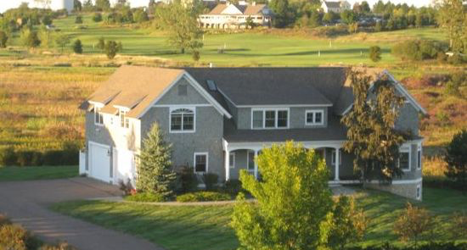
Location and segmentation
Notes:
This South Burlington 5.5 baths property had been on the market for more than 4 years. The ask price dropped from about $1.2 million to $839K.

Slide 33
Question
Why does it matter whether an asset (e.g., RE) is liquid or illiquid?
Does liquidity have an impact on asset prices (e.g., RE prices)?

Slide 34
High fees/costs for providing liquidity
For certain homes, Zillow's "Zestimate" — the online estimate of the home's value — will now represent an initial cash offer from the company to buy the property… without going through the hassle of a formal listing.
A Zillow employee inspects the home, provides a list of needed repairs and an adjusted final offer and the homeowner can pick a closing date.
Zillow charges sellers a fee of about 7.5% on average.
In addition, cross-selling of mortgage and other services?
A viable business model?
Source: CNN, 02/2021.

Slide 35
A stylized fact of real estate
That is, the use of debt—often the most important source of investment risk.
2006 Tishman Speyer apartment investment in Manhattan: 70% debt for the $6.3 billion Stuyvesant Town/Peter Cooper Village complex (later surrendered to creditors).
2012 Tishman Speyer office investment in L.A. : 54% debt for the $435 million Wilshire Courtyard.
Tishman Speyer learned a lesson?

